Slide 1

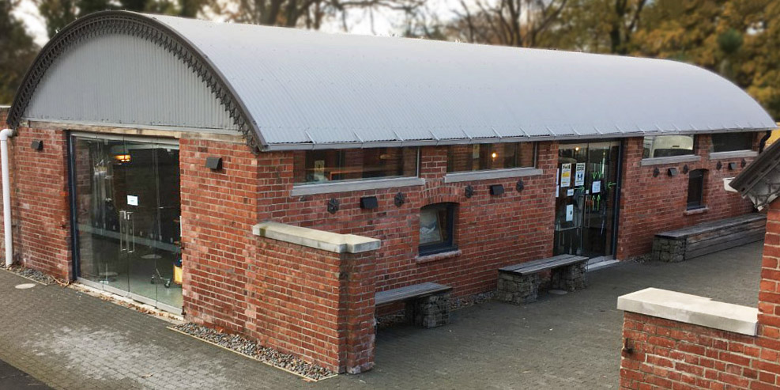
Junior Uniform
Senior Uniform
Shop Location
Welcome

Slide 2
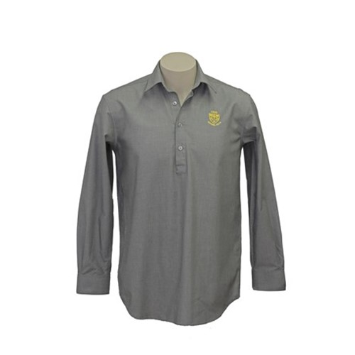
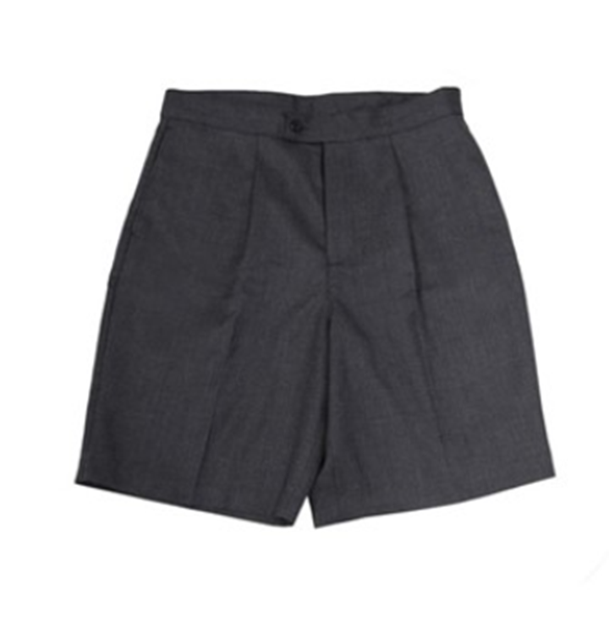
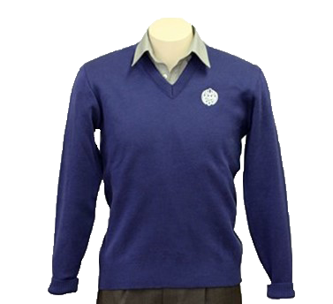
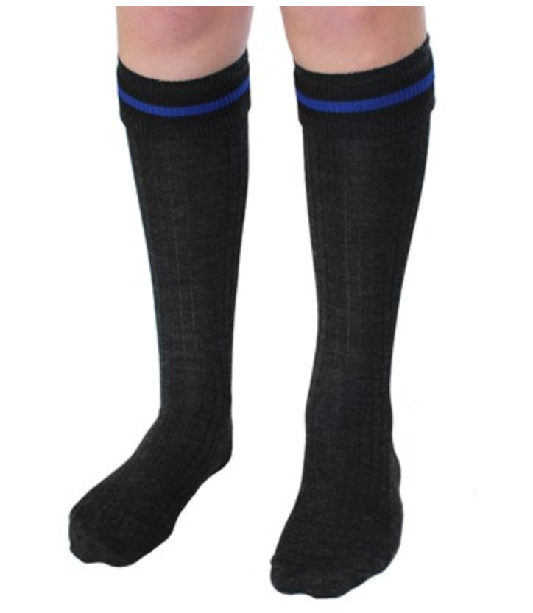
Junior Uniform
Senior Uniform
Shop Location
Grey shirt
Junior shorts
Junior socks
Junior jersey

Slide 3
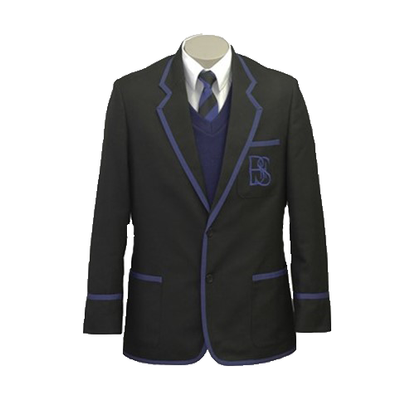
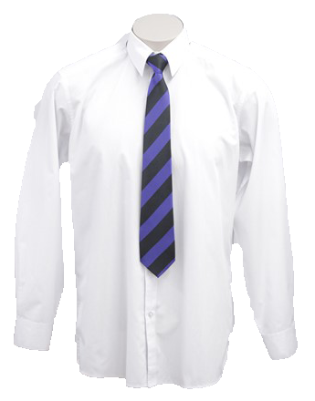
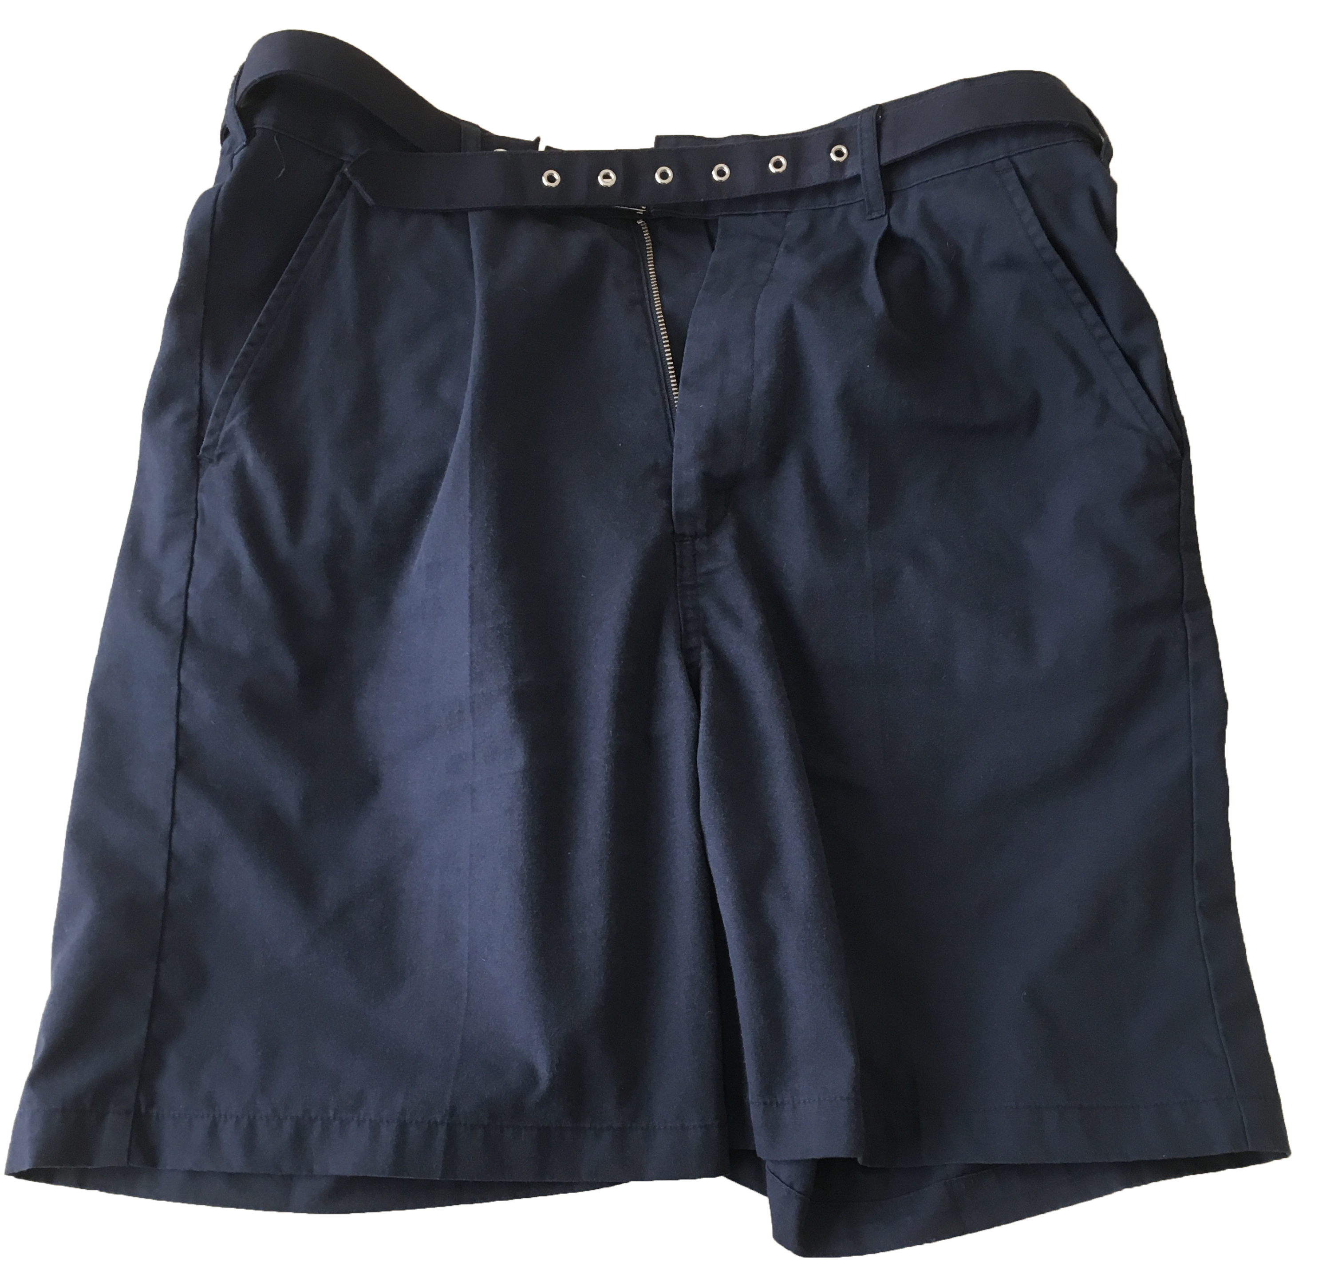
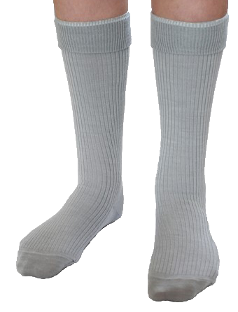
Junior Uniform
Senior Uniform
Shop Location
Senior shirt
Senior pants
Senior blazer
Senior socks

Slide 4
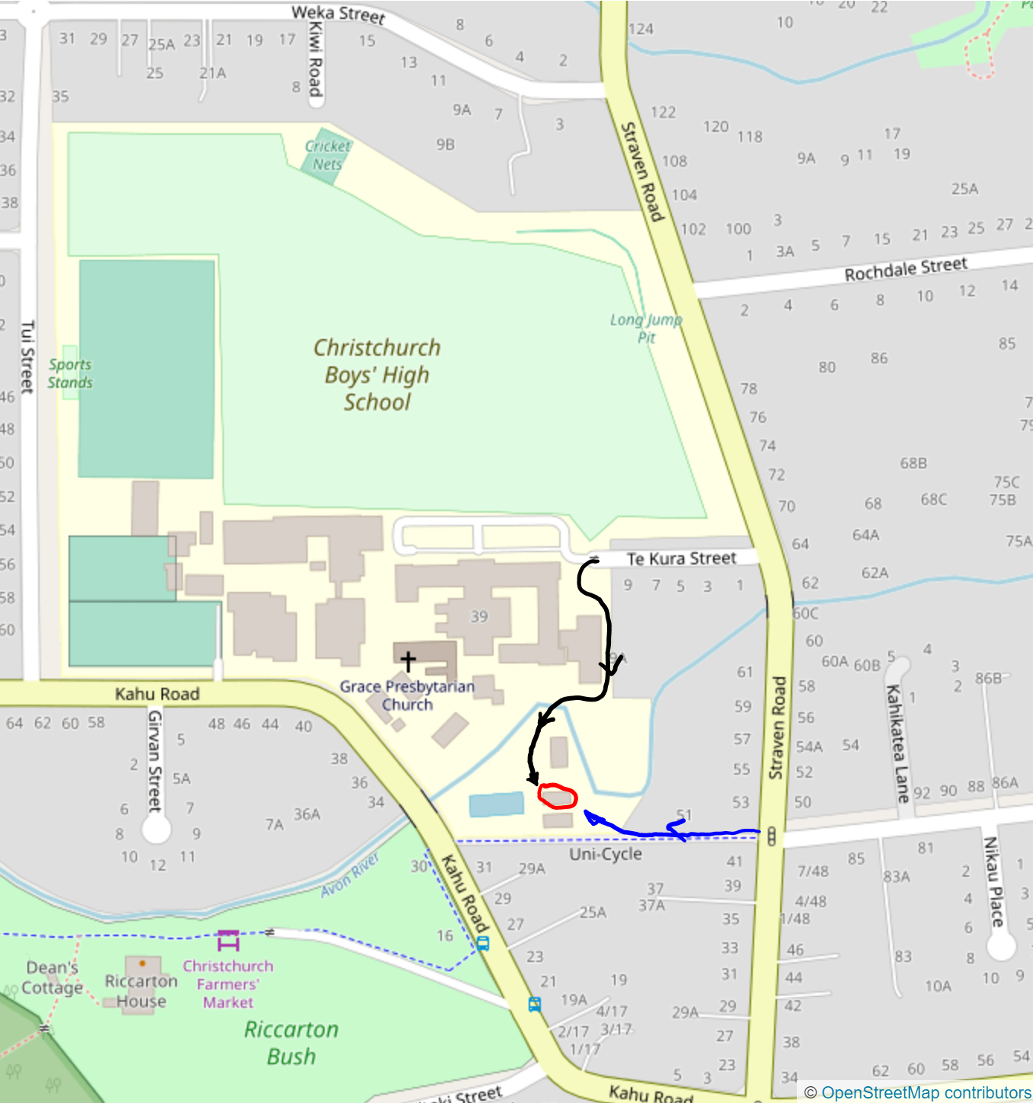
Junior Uniform
Senior Uniform
Shop location
Uniform Shop location
The shop is located on the south end of the school by the Deans buildings marked in red. There are two ways that is can be access. The first way is through the main gates following the black line on the map. The second way is following the blue line up a small drive next to the cycle way and 51
Current hours
Tuesday 2.45pm - 6.00pm
Thursday 1.00on -5.00 pm
First Saturday of the month 10.00am - 12pm
These hours continue through the term breaks.

